Slide 1
Shortest Path Algorithm

Slide 2
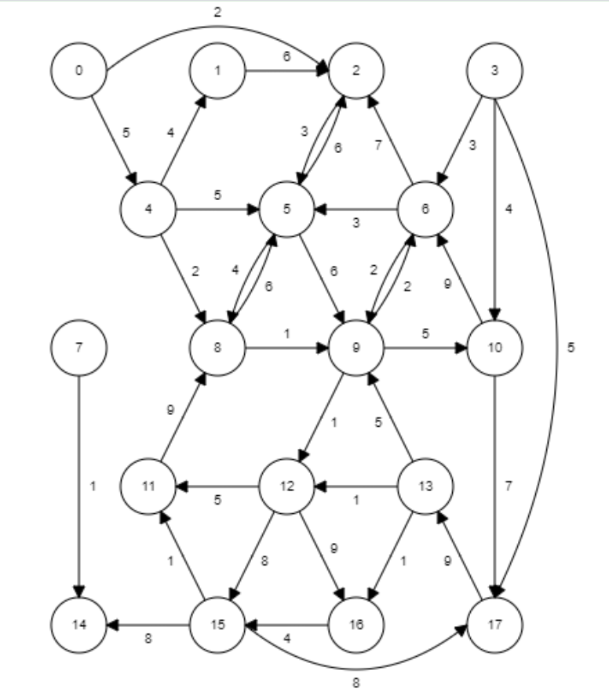
Finding shortest path

Slide 3
Creating Weighted Graph
Adjacency list
Adjacency matrix

Slide 4
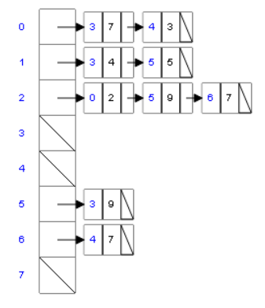
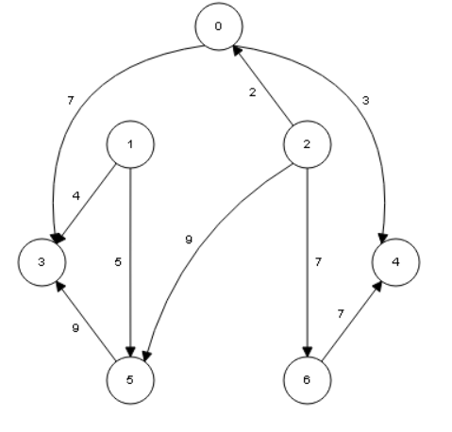
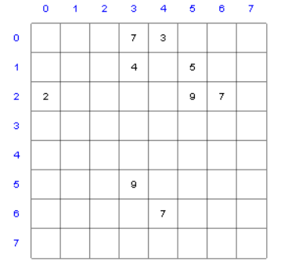

Slide 5
Adjacency list
To represent weighted graph, the link list will have to save two integers in every node. For this, a struct is to be declared
struct graphNode
{
int AdjNode;
int weight; //can also be a float
}
So link list type will be
list<graphNode> *Array

Slide 6
Shortest Path Algorithm
Weighted graphs
  When a graph uses the weight to represent the distance between two places
Weight of the path P
  Given G as a weighted graph with vertices u and v in G and P as a path in G from u to v
    Sum of the weights of all the edges on the path
Shortest path: path with the smallest weight

Slide 7
Shortest Path
Dijkstra Algorithm finds the shortest paths from a given node to all other nodes on a weighted graph
Weights should be non negative

Slide 8
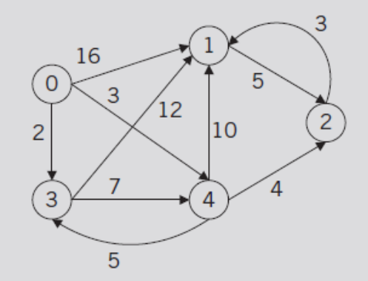
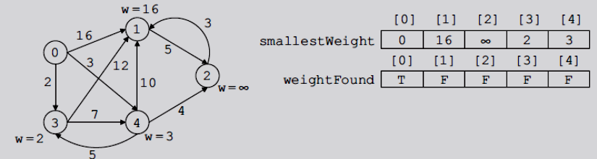
Shortest Path (cont’d.)
FIGURE 12-8 Weighted graph G
FIGURE 12-9 Graph after Steps 1 and 2 execute

Slide 9
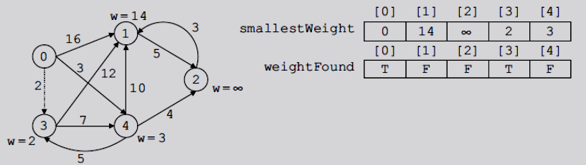
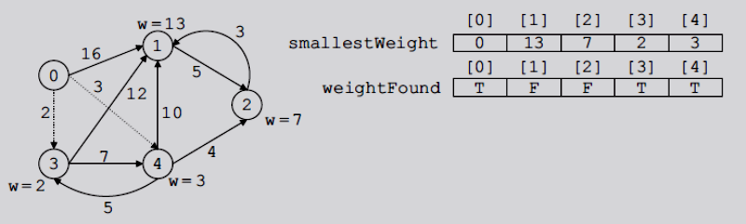
Shortest Path (cont’d.)
FIGURE 12-10 Graph after the first iteration of Steps 3 to 5
FIGURE 12-11 Graph after the second iteration of Steps 3 to 5

Slide 10
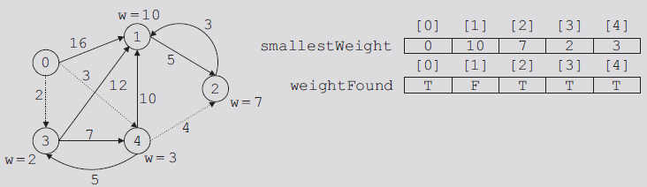
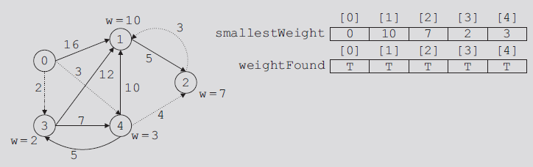
Shortest Path (cont’d.)
FIGURE 12-12 Graph after the third iteration of Steps 3 to 5
FIGURE 12-13 Graph after the fourth iteration of Steps 3 through 5

Slide 11
Class Definition
class wtdGraphAdjMat
{
public:
void createWtdGraph();
void shortestPath(int vertex);
void printShortestDistance(int vertex);
private:
double **wtdMat; //pointer to create weighted Adj matrix
double *smallestWeight; //pointer to create the array to store
//the smallest weight from source to other vertices
int *pred; // to store shortest path
int gSize;
};

Slide 12
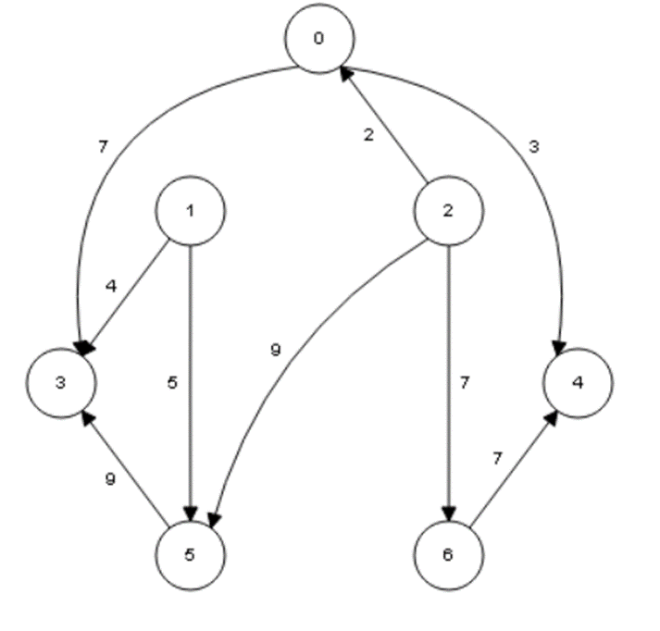
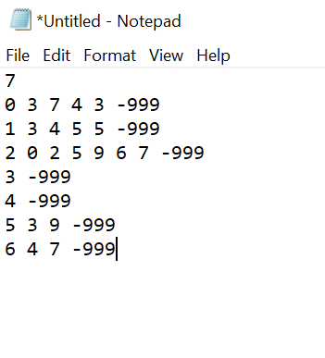
Text file representing a weighted graph

Slide 13
Text file representing a weighted graph
Number of vertices
Vertex number
Adjacent Vertice and its weight

Slide 14
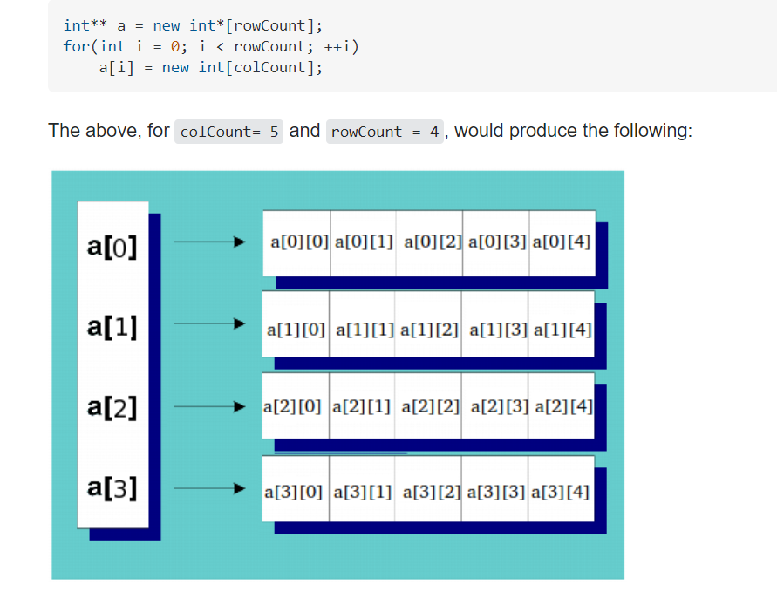
Dynamically creating a 2D array

Slide 15
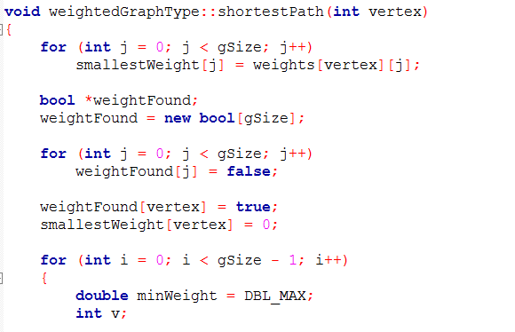
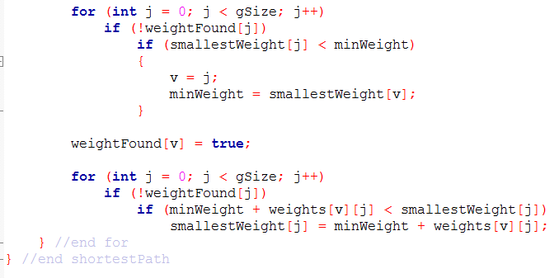
FIGURE 12-8 Weighted graph G

Slide 16
Shortest Path (cont’d.)
See code on pages 704-705
  C++ function shortestPath implements previous algorithm
    Records only the weight of the shortest path from the source to a vertex
Review the definitions of the function printShortestDistance and the constructor and destructor on pages 705-706

Slide 17
